Slide 1
EggBeater

Slide 2
Executive Summary: Purpose
To create an encryption system that provides superior file security
Eggbeater is a tool for generating encryption keys from fingerprints

Slide 3
Executive Summary:
Design and Methodology
MVC Architecture
  Alterations
Agile Development
  Modified Test-Driven Development
    Unit Testing
    Acceptance Testing
  Object-Oriented Programming
    Embedded Modifications

Slide 4
Executive Summary: Conclusion
What we finished
What we hoped to do
How our design helps us accomplish what we hoped to do

Slide 5
Research
GUI frameworks
  Qt
  Wxwidgets
Fingerprint modules
  GT511C1R
Encryption libraries
  Crypto++
  OpenSLL, OpenAes, CyaSLL

Slide 6
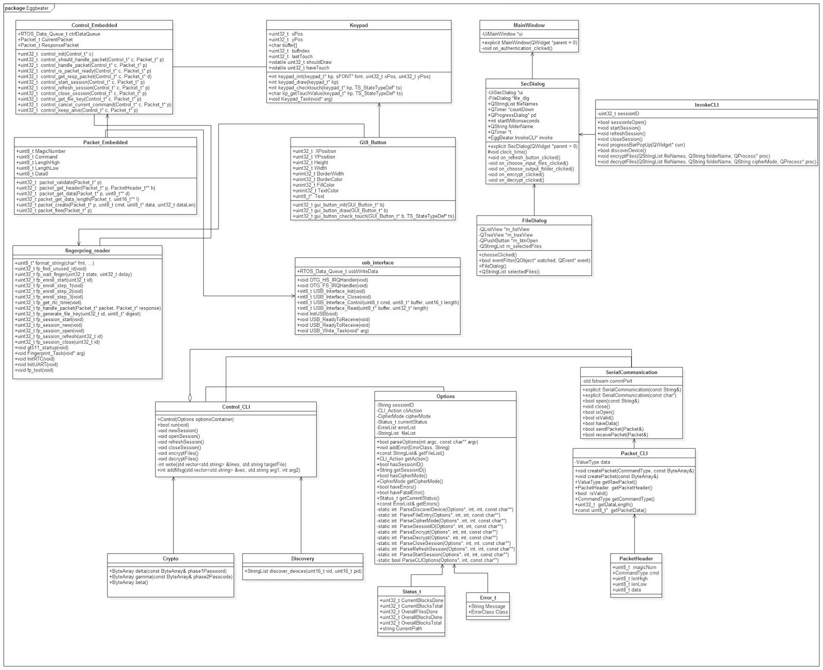
Design: Overall

Slide 7
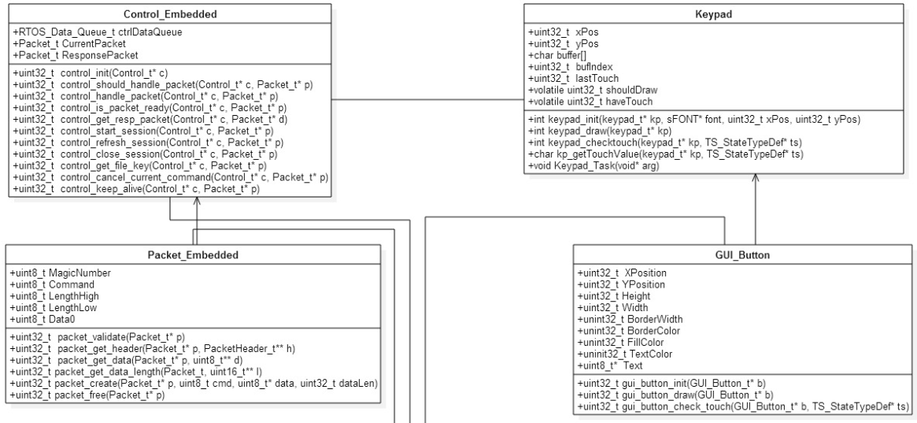
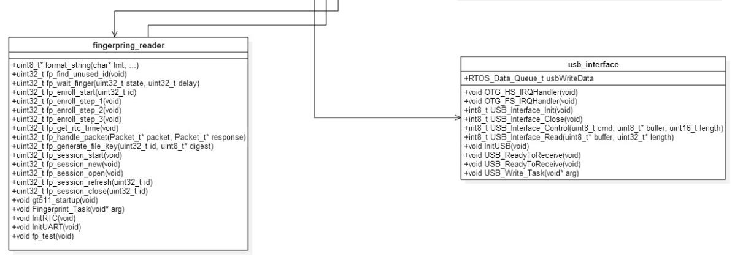
Design: Embedded

Slide 8
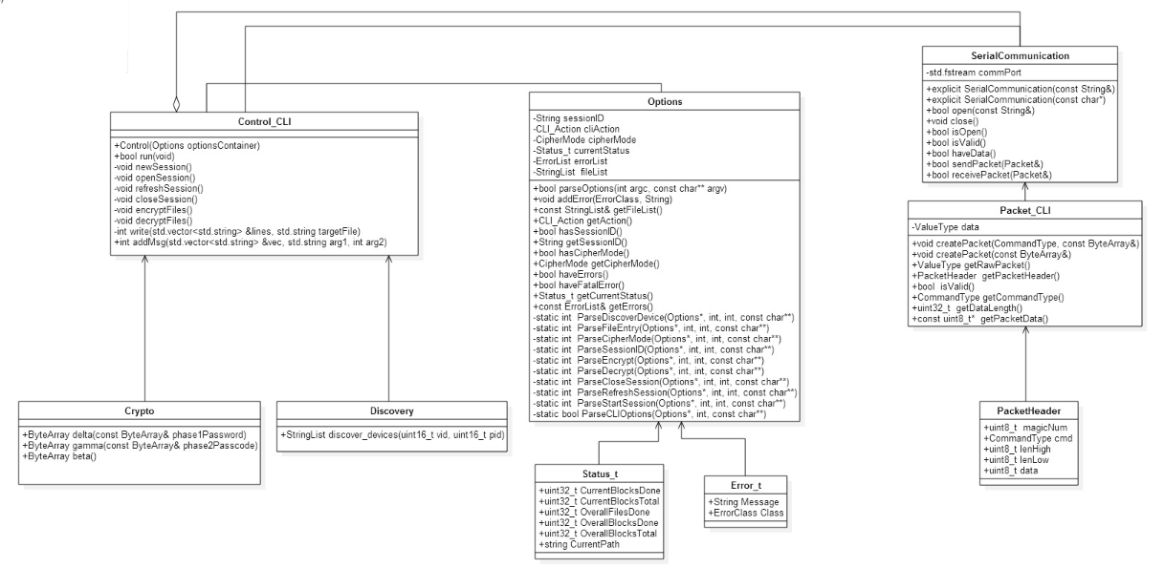
Design: Command line

Slide 9
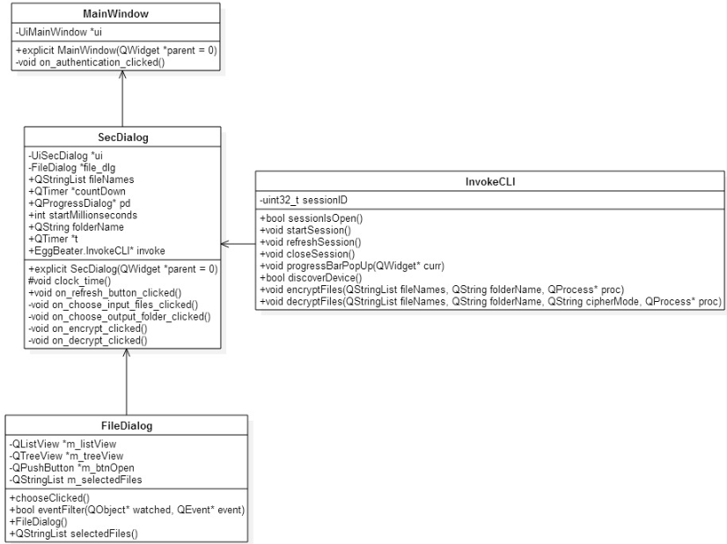
Design: GUI

Slide 10
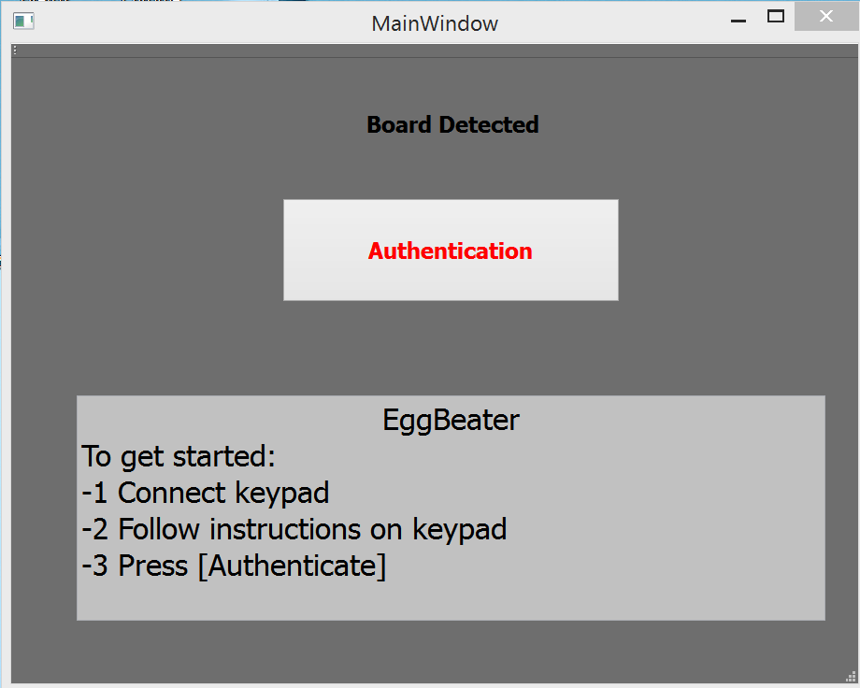
Final GUI Mockup
Notes:
Open GUI and screenshot.

Slide 11
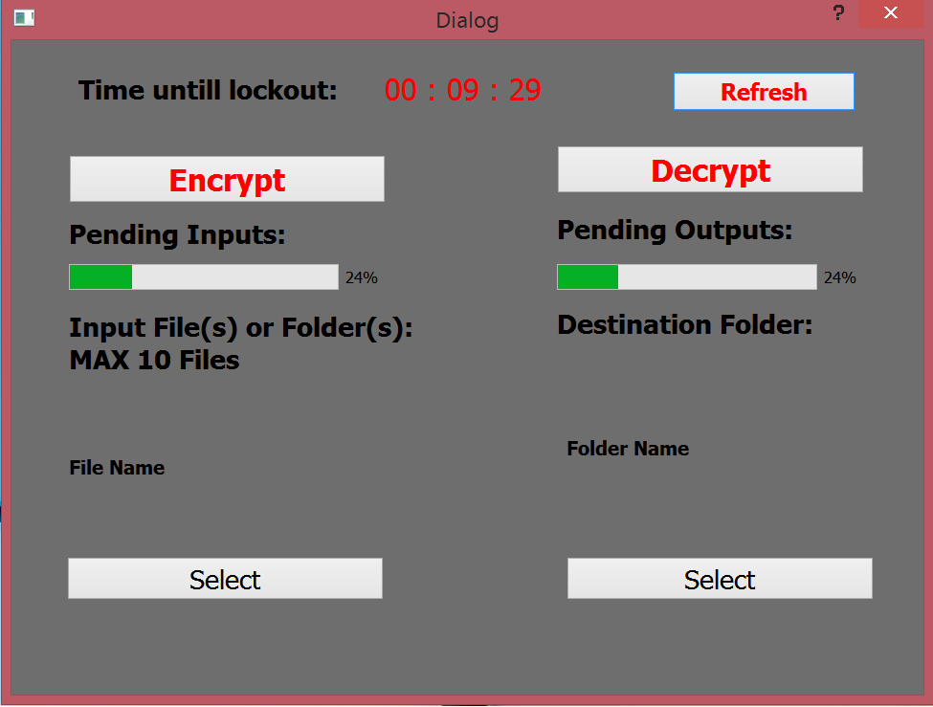
Final GUI Mockup(cont.)

Slide 12
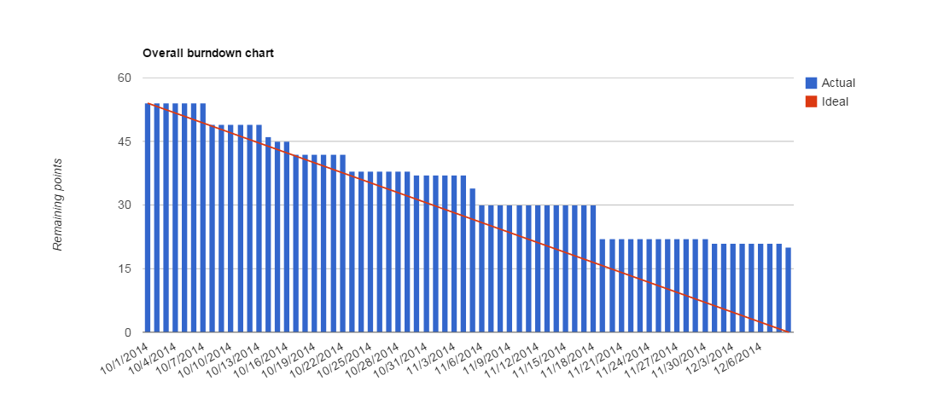
Top-Level Burndown

Slide 13
Testing
Unit testing
  Crypto
  Command Line
Acceptance testing
  Hardware interactions
  Device discovery

Slide 14
Test Coverage
Test Coverage
  Example -> Encryption Modes
  # Unit Tests & # Acceptance Tests
  The Untested
    Qt

Slide 15
Metrics
Cyclomatic Complexity
  Embedded Avg = 3.84
  CLI Avg = ##
  GUI Avg = ##
Cohesion
  ##

Slide 16
Maintainability
Split design between three domains
  Embedded
  Core tool (command line)
  GUI wrapper of core tool

Slide 17
Extensibility
Software
  Encryption Schemes
  GUI options
  Mac Compatibility
  Linux Compatibility
    Qt works!
Hardware
  Microcontroller
  Keypad

Slide 18
Presented By
Robert Beat
Sterling Miller
Sam Adams
Yuki Ishikawa
Sam Whitsett
Andrew Barton

